Slide 1
BIG DATA GROUP PROJECT Problem Statement & Objective:
To create analytical report and visual presentation using HDP tools and techniques with data provided that will benefit decision-makers.
Use truck fleet data to refine and analyze trucking movement in order to meet the organizational goal of better understanding risk.
The objective is to identify dangerous commercial truck drivers nationwide, as truck accidents is a leading cause of injuries and deaths in United States.

Slide 2





Loading Data into Hadoop File System (HDFS)

Slide 3
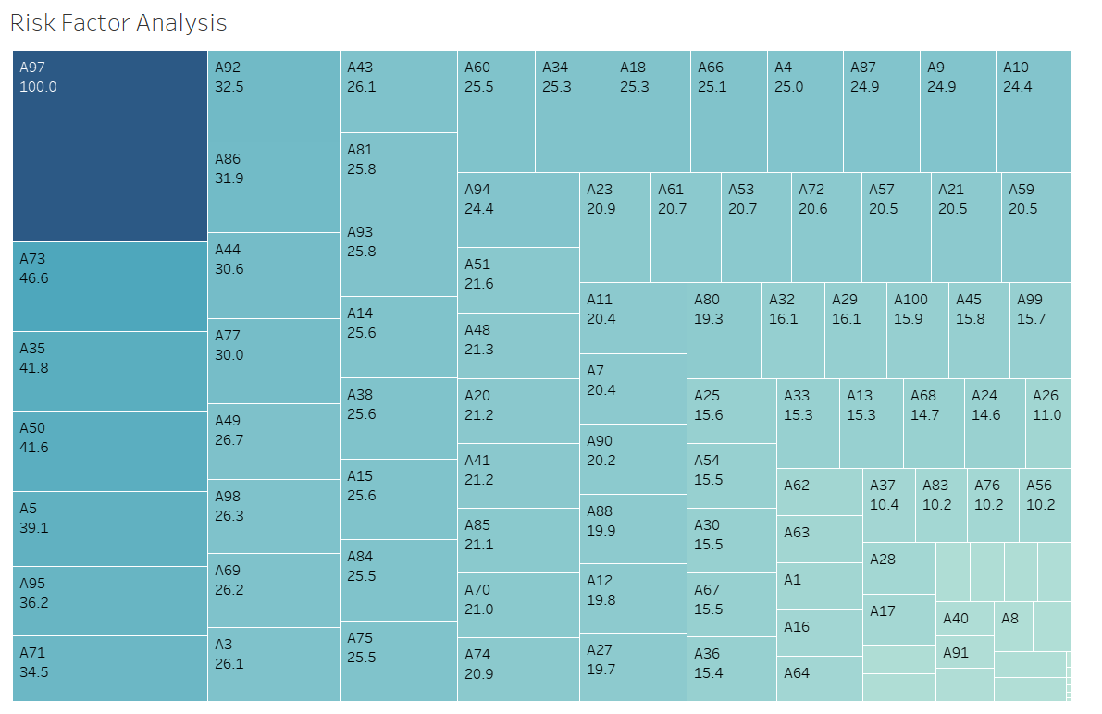
Risk Factor Analysis:

